Slide 1
API project
brebared by : Asmaa Saif Zidan
Under supervision DR :Amany shousha

Slide 2
TABLE OF CONTENTS
01
What is API &How works
02
Benfites of API
03
Tools oF API
04
Demo of Project
postman ,newman,RestAssured

Slide 3
API
What is an API is a set of rules or protocols that let software applications communicate with each other to exchange data, features and functionality.

Slide 4
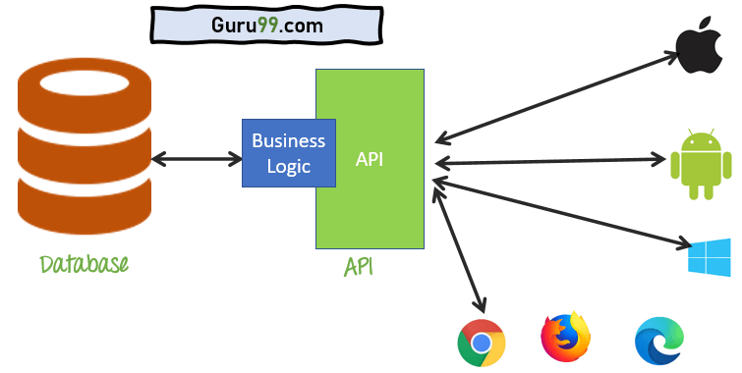

Slide 5
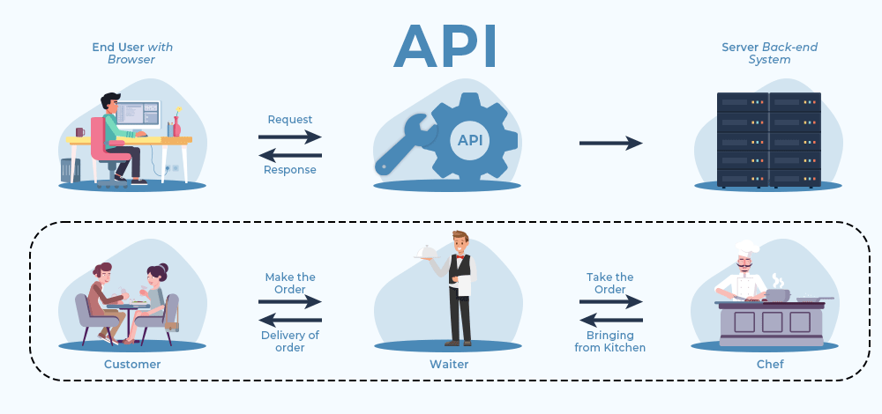

Slide 6
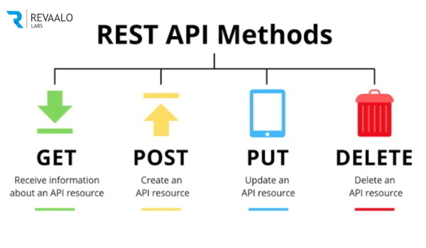

Slide 7
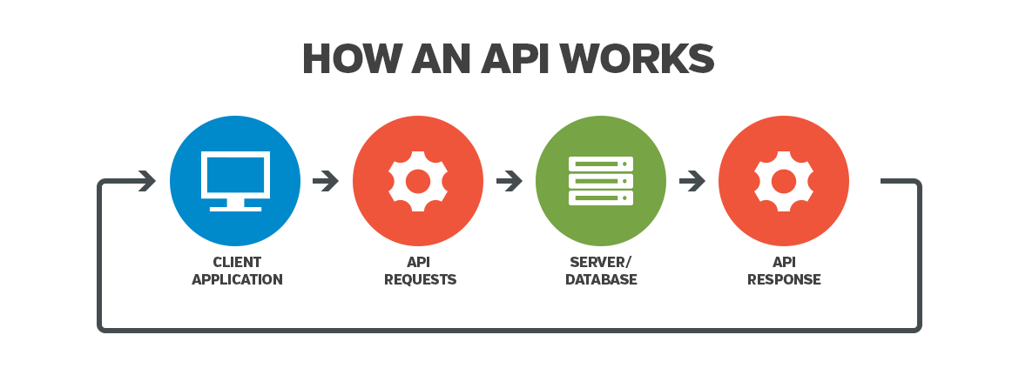
ACTIVITIES
Saturn is a gas giant and has several rings
GOALS
FEEDBACK
Jupiter is the biggest planet of them all
Mercury is the closest planet to the Sun

Slide 8
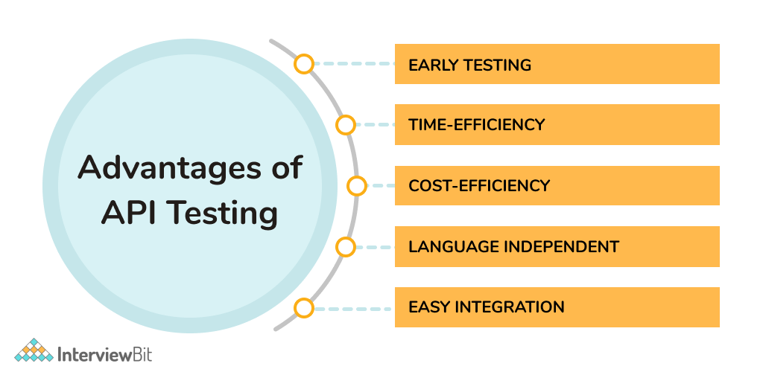
What are the benefits of APIs?
2. API request

Slide 9
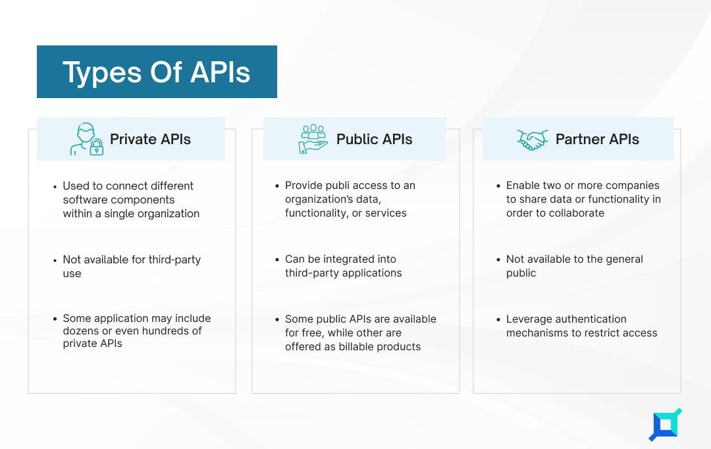
80%
95%
VENUS
SATURN
FEATURES
NEPTUNE
MERCURY

Slide 10
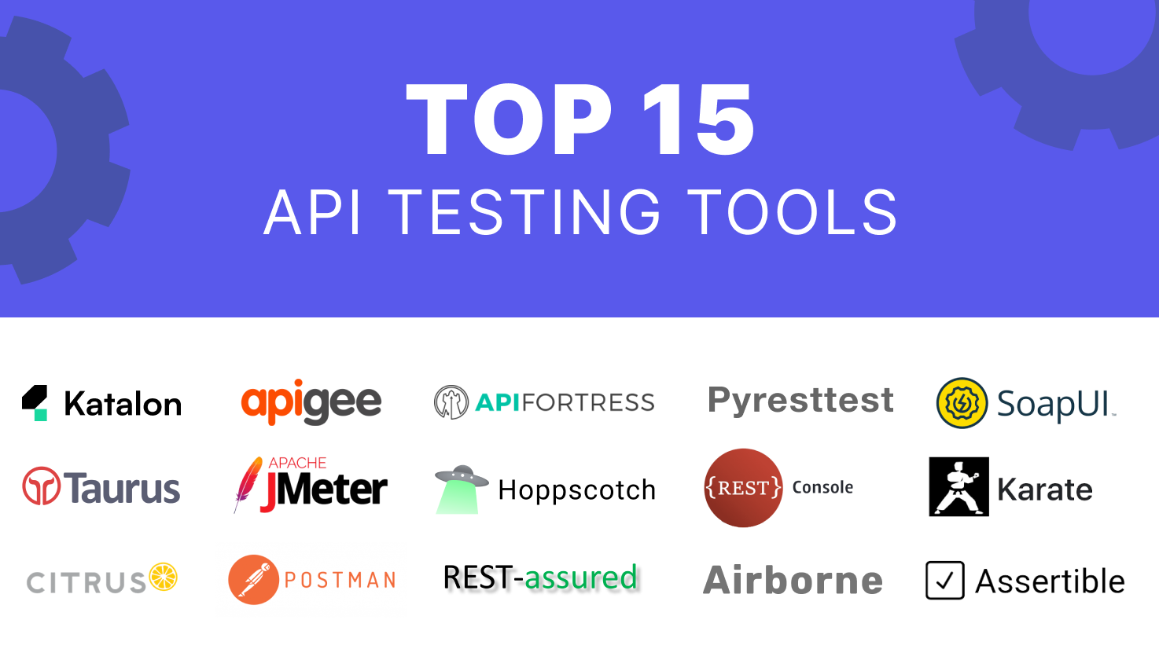
API Testing Tools

Slide 11
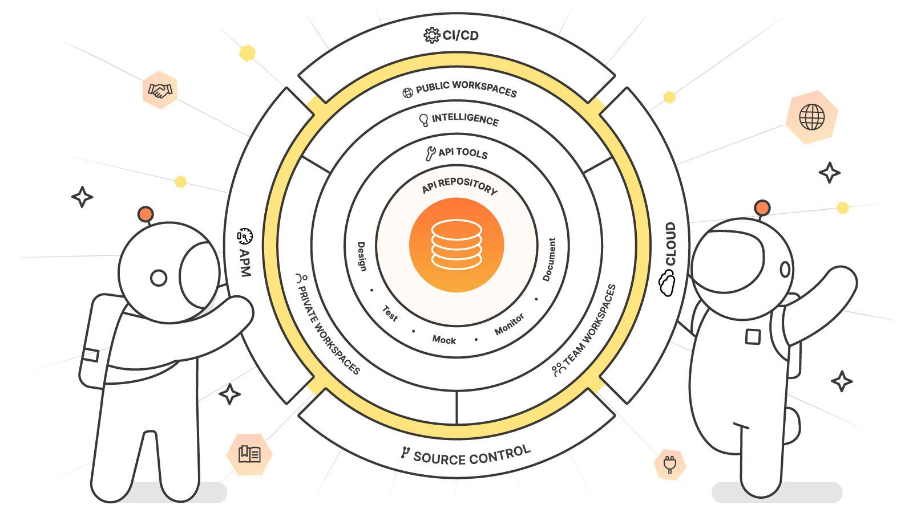
What is Postman?
Postman is an API platform for building and using APIs. Postman simplifies each step of the API lifecycle and streamlines collaboration so you can create better APIs—faster.

Slide 12
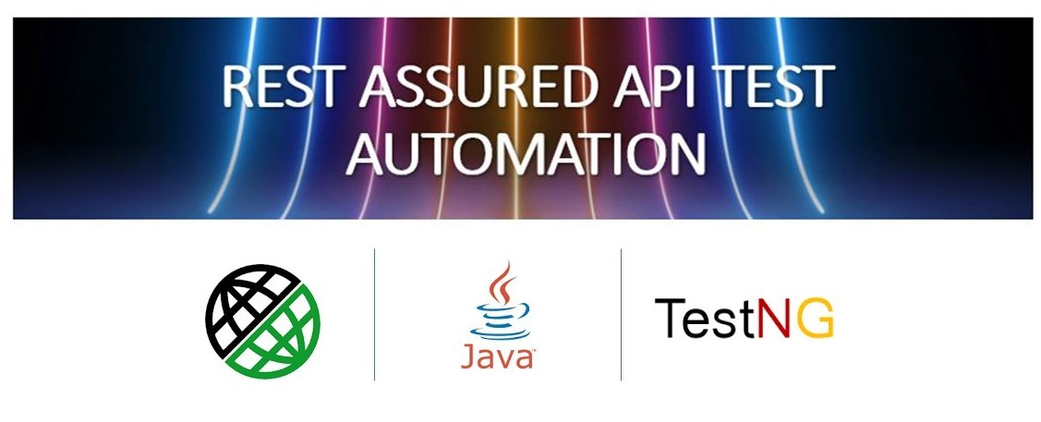
REST-Assured
REST-Assured is a Java library for testing RESTful web services. It is used to invoke REST web services and validate requests & responses. REST-Assured is an open-source API test automation tool for testing.

Slide 13
API project
1-
2-
Demo blaze Website and Platz Fake Store API Write test cases
3-
Postman &Newman
4-
Rest Assured
Happy scenario &Bad Scenario
Html Report
Allure Report & Bug Report

Slide 14

Run Demo project

Slide 15


